Slide 1


Value Proposition DevOps
Web Apps
Mobile Apps
Logic Apps
API Apps
Continuous Deployment + Continuous Integration = Continuous Delivery
Continuous Happiness ☺
Notes:
App Service has everything you need to build apps that target both web and mobile clients from a single app back-end.
Using API Apps, you can connect your app to dozens of popular services like Office 365 and salesforce.com in minutes, and integrate your own APIs so they can be used within any app.
And finally with Logic Apps, you can automate business processes using a simple no-code experience.

Slide 2
Our Value Proposition Principles
Simplify Customer Dev and Ops Landscape
Leverage Current Tools, Knowledge and Technologies
Improve Developer and Operations Experience
All the above while mantaining a scalable and friendly Cost Structure ☺
In summary: Add Real Value for Java Customers
Notes:
App Service has everything you need to build apps that target both web and mobile clients from a single app back-end.
Using API Apps, you can connect your app to dozens of popular services like Office 365 and salesforce.com in minutes, and integrate your own APIs so they can be used within any app.
And finally with Logic Apps, you can automate business processes using a simple no-code experience.

Slide 3
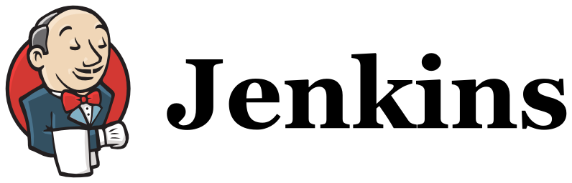
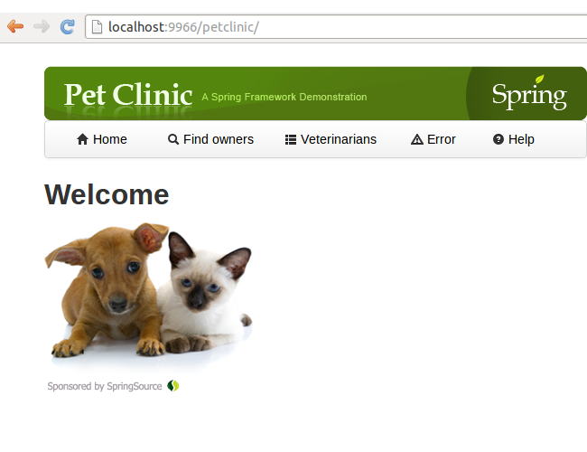



Traditional Java EE DevOps
Continuous Deployment
Release
Code Repository
Compile
Unit Testing
Deploy
On-Prem Infra
(usually non redundant)
On-Premises Dev /Test /prod
Eclipse
IntelliJ

Slide 4
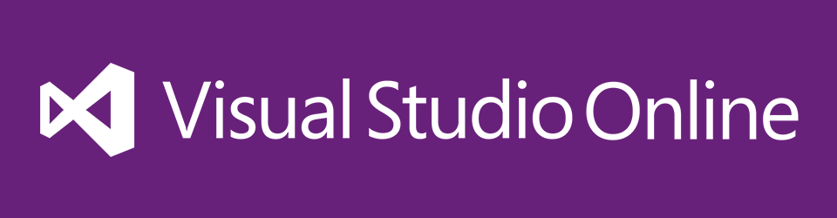
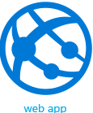
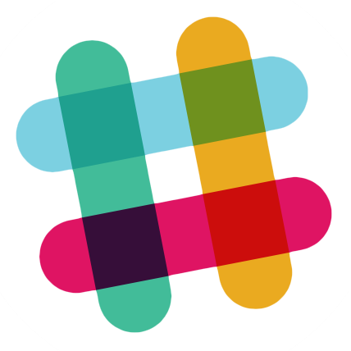
MSFT Cloud Powered- Java EE DevOps: WebApp
Release
Continuous Deployment
Azure
Code Repository
Compile
Unit Testing
Deploy
Slack
Eclipse + Team explorer everywhere

Slide 5

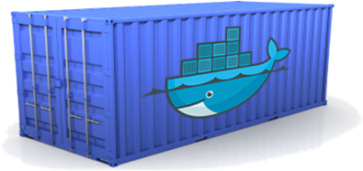
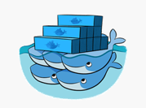

MSFT Cloud Powered- Java EE DevOps & Azure Container Services
Release
Continuous Deployment
Azure
Code Repository
Compile
Unit Testing
Deploy
Slack
Eclipse + Team explorer everywhere

Slide 6
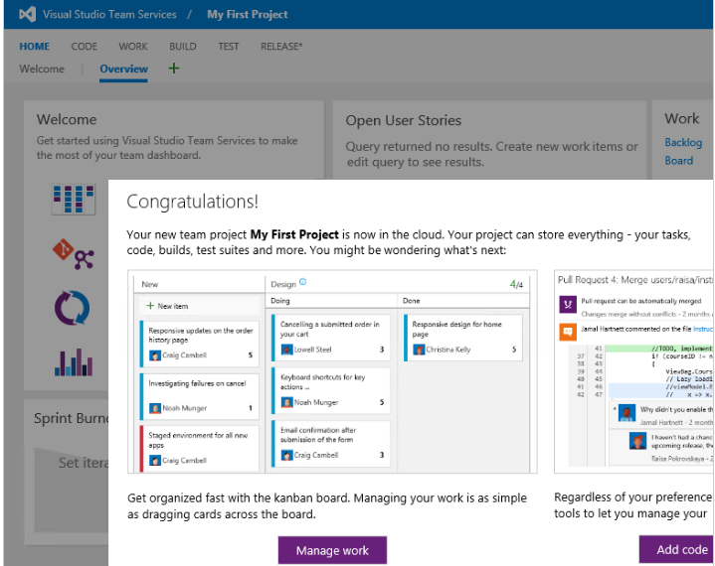
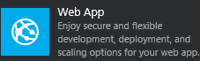
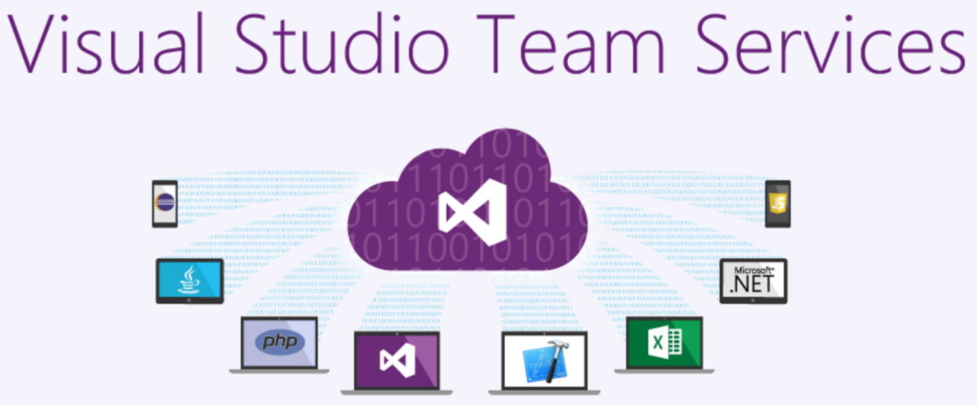




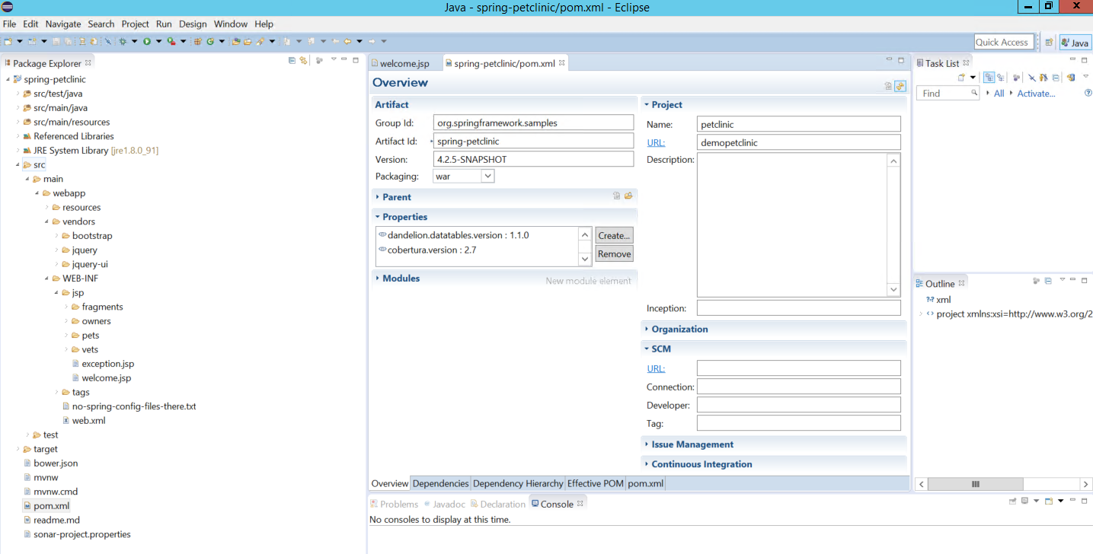
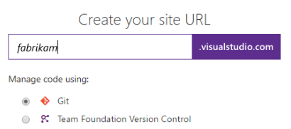

Java DevOps CI, VC, CD….. Ver 1
Azure
VSTS
Dev Env
Visual Studio Team Services /Project
Eclipse IDE
Web App (Website)
Maven
GIT / Slack
Web App / Apache &Tomcat / VM Apache Maven
GIT
Java Source Code
Azure & Team Services

Slide 7
Results
Simplify Customer Dev and Ops Landscape
Leverage Current Tools, Knowledge and Technologies
Improve Developer and Operations Experience
All the above while mantaining a scalable and friendly Cost Structure
Improve Scalability and Portability with Azure Container Services
Redundant Cloud Repository and Integration Infraestructure
Reused All Eclipse, Git, Tomcat and Maven Assets
No Intallation or Infra. Minimal Configuration. Slack integrated
Starting From $0. – Ten Free Websites, Free VSTS Up to 5 team members

Slide 8
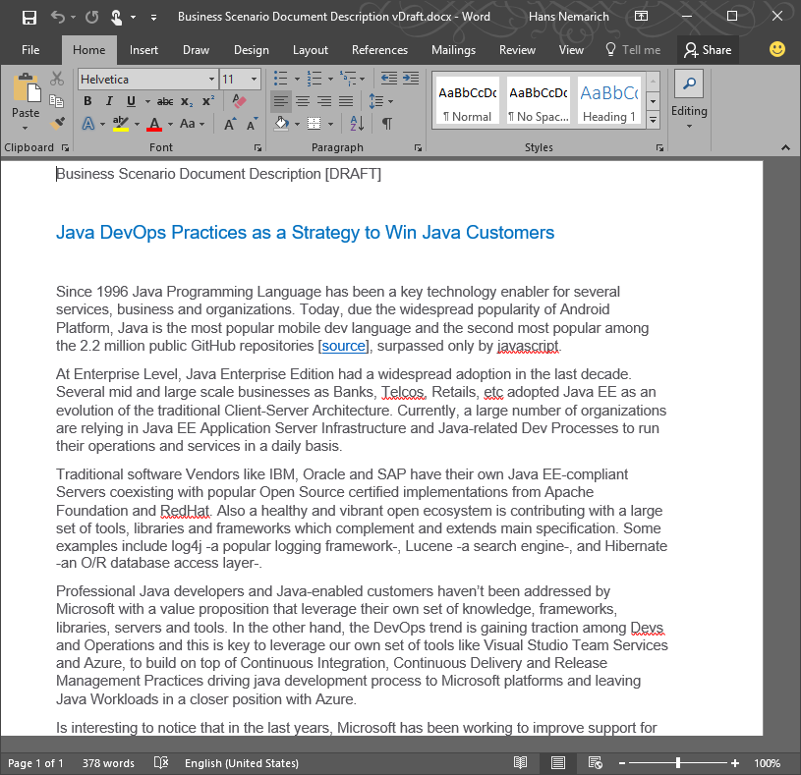
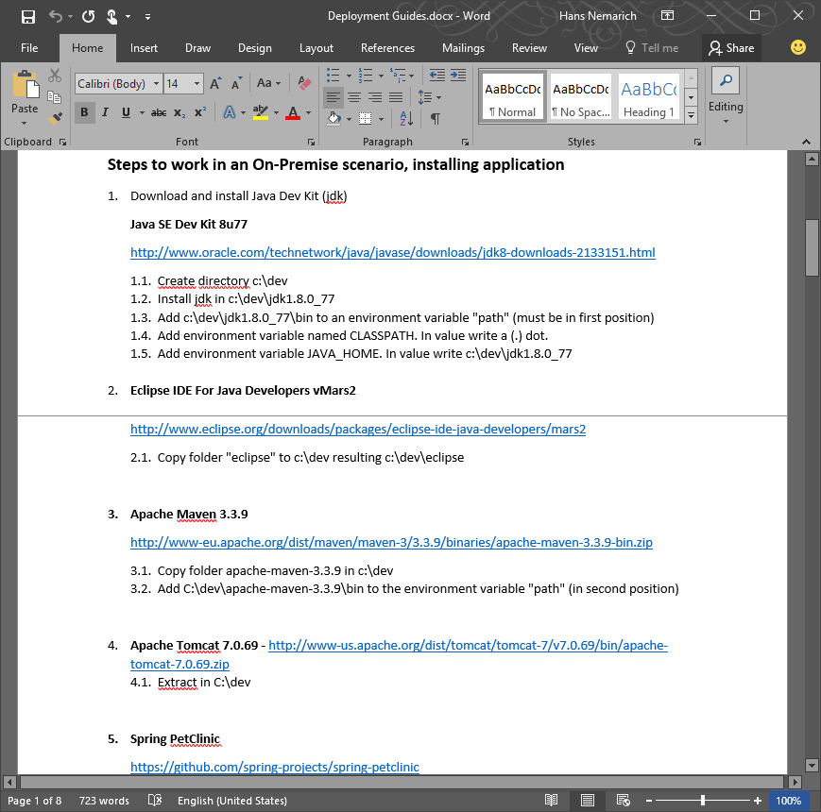
Business Scenario Description
Deployment Guide

